Slide 1
Personalised liver stereotactic body radiation therapy using magnetic resonance imaging The PRISM clinical trial
Sirisha Tadimalla, PhD Cancer Institute NSW Early Career Fellow/MRI Physicist Institute of Medical Physics, The University of Sydney sirisha.tadimalla@sydney.edu.au
Notes:
Thanks Annette. Hi everyone. Many of you already know me. I have been at USyd for about 4.5 years now and a part of the BiRT research team throughout. Just a little bit of background – I am an MRI physicist, so if you have any questions around MRI, how it works, how you might be able to use it in your clinical work or research, I am always happy to help. So….the PRISM clinical trial.

Slide 2
This presentation has been modified for the purpose of sharing general knowledge. Slides that contain unpublish work have been edited to include the words “redacted” where the unpublished work has been removed.

Slide 3
Personalised liver stereotactic body radiation therapy using magnetic resonance imaging The PRISM clinical trial
to enable more patients with primary liver cancer to receive radiation therapy
Notes:
Our main goal with this work is quite simple. We would like to make it possible for more patients with primary liver cancer to be able to have radiation therapy as an option to treat their cancer.

Slide 4
Contents
Primary liver cancer
Stereotactic body radiation therapy (SBRT/SABR)
Magnetic resonance imaging (MRI)
The PRISM clinical trial
Notes:
Tseveral of our new Masters students are here today so I will try and give a more detailed introduction to the topic before heading off into the details. I will start off with a brief introduction to liver cancer, a little bit about radiation treatment of liver cancer and the technique that has made it possible SBRT, and move to MRI and how it can be used in this context. And some details of the clinical trial and what we have been doing, how far we’ve got and so on…

Slide 5
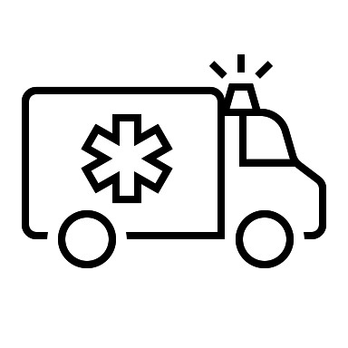
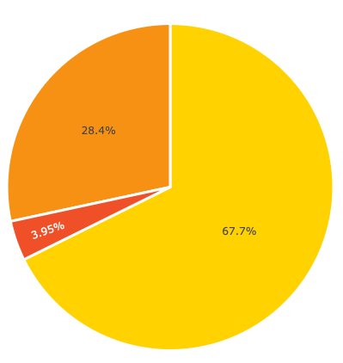
Primary liver cancer
3000
70%
HCC
1 in 5
in Australia
will survive > 5 years
HCC: Hepatocellular carcinoma
Notes:
Around 3000 people in Australia were diagnosed with primary liver cancer last year. There are several types of primary liver cancer, but the biggest chunk around 70% is taken up by hepatocellular carcinoma, or HCC. This is a cancer of the hepatocytes, or the main liver cells. Sadly, one in five patients don’t survive beyond 5 years from diagnosis. And this statistic hasn’t improved very much over the past few decades.

Slide 6
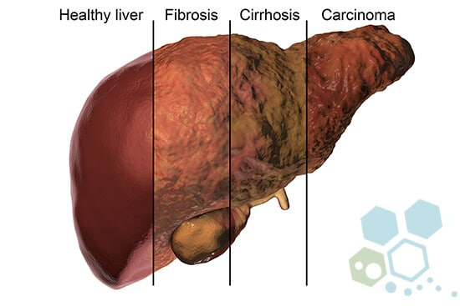
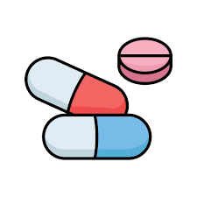
HCC
Many patients with HCC have underlying cirrhosis and loss of liver function
Notes:
There are several pathways that sort of culminate with HCC. But it usually starts due to some form of repeated exposure to triggers that cause inflammation of the liver cells. Some of these triggers are well known such as alcohol. Others include things like obesity and associate Type-2 diabetes which leads to non-alcoholic fatty liver disease. There are several medications and drugs that can also cause liver inflammation if taken over long periods of time or at high doses. For example, you may have heard of Paracetamol related liver injury. The most common trigger for HCC worldwide are the hepatitis B and C viruses. So the chronic inflammation leads to fibrosis, which is basically the formation of scar tissue in the liver. As this becomes more severe, the liver becomes cirrhotic and at this point, many patients also have a loss in liver function. So many patients with HCC are also found to have reduced liver function.

Slide 7
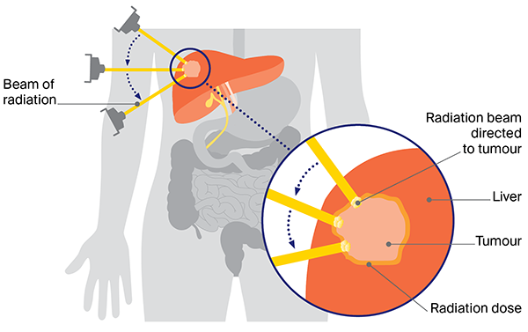
Radiation therapy for liver cancers
large amounts of radiation
side effects
Notes:
So how could radiation therapy be used to treat HCC. We use several beams of radiation and target the tumour with a large dose. If the dose is sufficiently large, you can destroy all the cancer cells in the tumour – this is called curative, as in the aim is to kill the cancer and try to cure the patient. But…..
The radiation dose to the tumour is limited by the other organs around the liver, as well as the rest of the liver outside of the tumour. Liver tissue is very sensitive to radiation and there is the risk of radiation induced liver damage, which for some patients can be fatal.

Slide 8
Stereotactic body radiation therapy (SBRT/SABR)
~5 treatments over 2 weeks
daily treatments over several weeks
precise, high dose to tumour
Chen et al, World J Gastroenterol 2021; 27:2434
Notes:
So stereotactic body radiation therapy or SBRT or SABR as it is called is an advanced radiation treatment delivery technique where very high doses can be delivered in a very precise way. And this can be done over fewer treatments or fractions over a course of a couple of weeks, compared to daily treatments over several weeks with conventional radiation therapy. So SBRT can to an extent solve the problem with radiation damage to the liver.

Slide 9
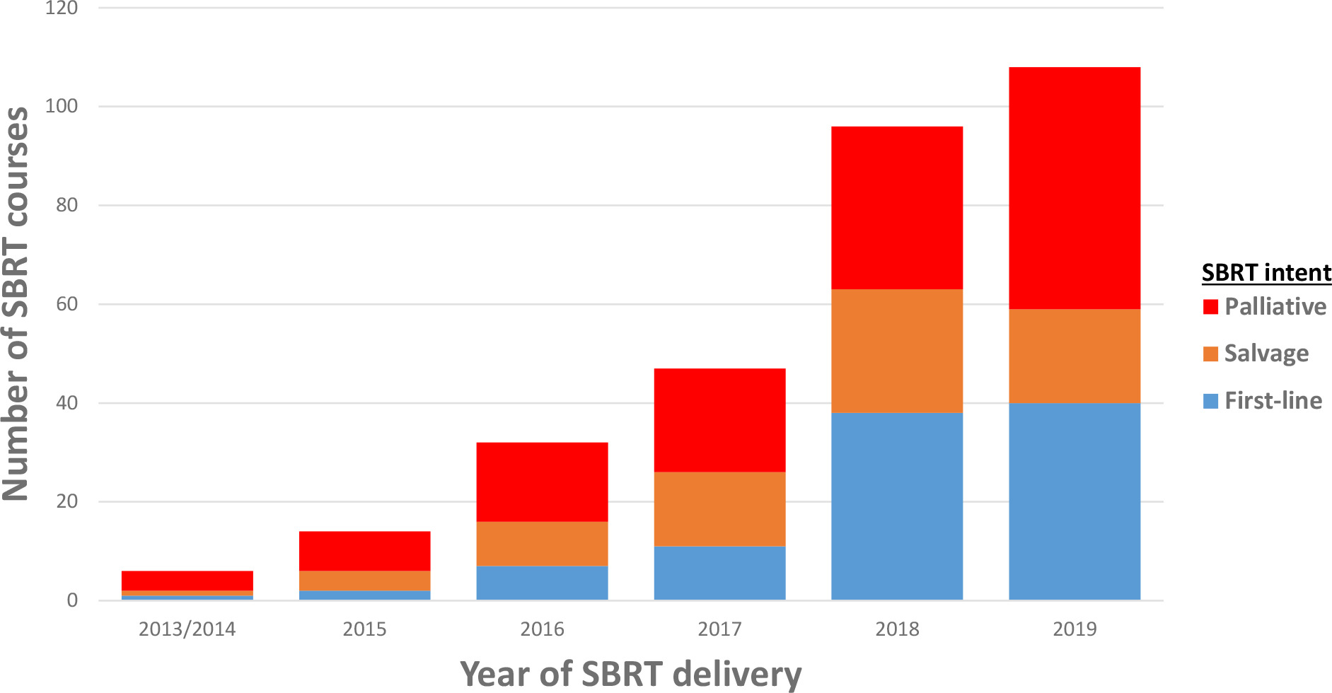
SBRT for HCC in Australia
Liu et al, JMIRO 2021; 65:3
Notes:
So it is not surprising that more and more centres are treating HCC patients using SBRT. This is a graph from a paper in JMIRO from 2021 which looked at the use of SBRT across centres in Australia and clearly the number of SBRT treatment has gone up over the years. The intent of the treatment as the colours show can be first-line, salvage or palliative. First-line means that the treatment was given with the intention to cure, salvage means the paitents had other treatment before the SBRT and palliative means the treatment was given to alleviate symptoms.
The SOCRATES-HCC clinical trial is currently underway in Australia which will help in increasing the number of first-line SBRT treatments for early stage HCC.
There are several things that go into how these decisions are made, of course, but one of them is the patient’s baseline liver function.

Slide 10
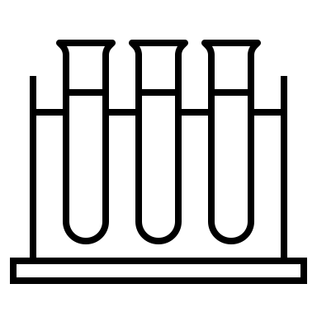
Baseline liver function
Child-Pugh (CP) score
CP A (5-6) | CP B (7-9) | CP C (10 and above)
Good liver function | Moderate liver function | Poor liver function
Notes:
Currently, baseline liver function is assessed mainly using blood tests and qualitative assessment of ascites and encephalopathy, which is all combined into a score. This is the Child Pugh scoring system and the scores can go from 5 to 15. Based on the score, liver function is classified into three groups A, B and C which basically represent good moderate and poor liver function overall.

Slide 11
Baseline liver function
CP A (5-6) | CP B (7-9) | CP C (10 and above)
Good liver function | Moderate liver function | Poor liver function
curative
good outcomes
low risk of radiation-induced liver disease (RILD)
B7 (maybe B8/9): eligible
not curative
high risk of RILD
If we reduce the risk of RILD, can some of the CP B patients also have curative treatment?
Notes:
For patients in the CP A category, as the baseline function is good, SBRT is often curative. So higher radiation doses are prescribed to the tumour, and for these patients, outcomes from SBRT are very good. And this is possible because they have a low risk of developing radiation induced liver disease.
At the other end, for patients with CPC scores, the liver function is just too low, and generally SBRT is not an option at all.
For patients with CP B scores, generally B7 patients are eligible for SBRT. And depending on the patient and the doctor and the country, B8 and even B9 patients may be eligible. But the treatment given to these patients is often not curative because there is a high risk of radiation induced liver disease, which in many cases is fatal.
So the question is, if we can reduce the risk of radiation induced liver disease, can some of the CP B patients also have curative treatment?
And in that case, how can we reduce the risk of radiation damage to the liver?

Slide 12
Baseline liver function
no spatial information
CP A (5-6) | CP B (7-9) | CP C (10 and above)
Good liver function | Moderate liver function | Poor liver function
Liver function is not uniform
Notes:
We know that liver function in cirrhotic patients is not uniform. There are actually good, moderate and poorly functioning regions of the liver. So what we need is a way to obtain that spatial variation. the blood tests cannot give any spatial information. And this is where imaging will obviously be very useful.

Slide 13
The concept of PRISM
Use MRI to measure patient’s regional liver function to
protect high functioning regions
sacrifice low functioning regions
increase dose to tumour?
Liver can repair - what is the threshold dose?
Mid-treatment MRI for adaptation to
reduce dose to improve safety,
or increase dose to improve chances of cure
functional sparing in lung RT

Slide 14
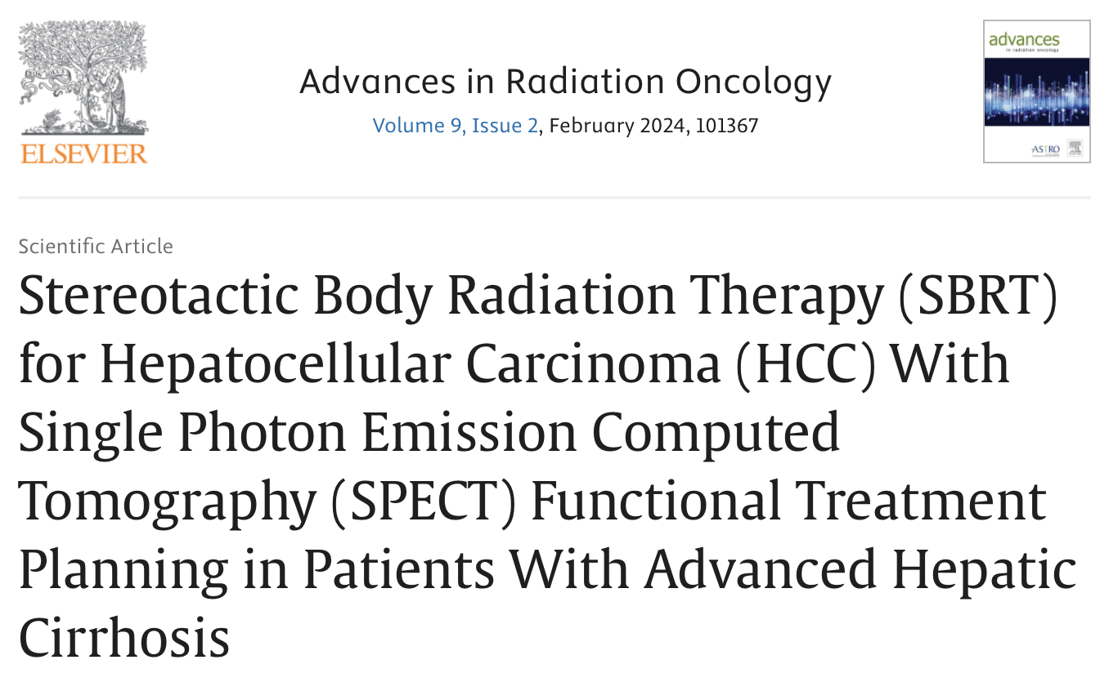
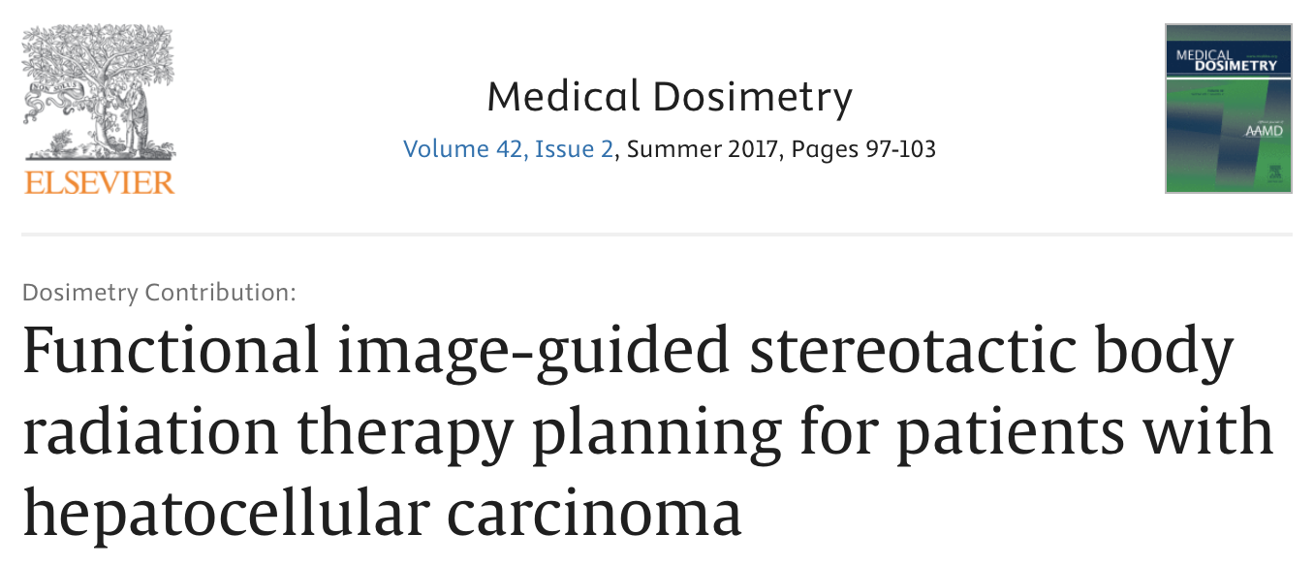
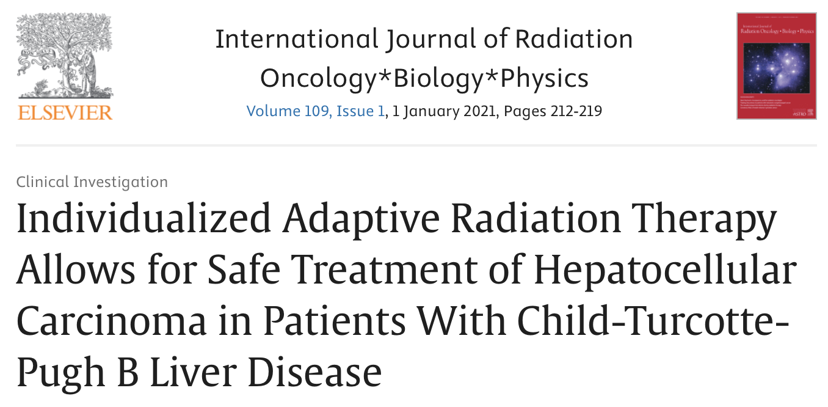
Literature
“Functional treatment planning with 99mTc sulfur colloid SPECT/CT allows identification and avoidance of functional hepatic parenchyma in patients with CP-B/C cirrhosis, leading to low toxicity and satisfactory transplant outcomes”
“EOB-MRI–guided SBRT planning using the IMRT technique may improve functional liver preservation in patients with HCC”
“Individualized adaptive treatment approach allows for acceptable toxicity and effective local control in patients with HCC and CTP-B liver disease”

Slide 15
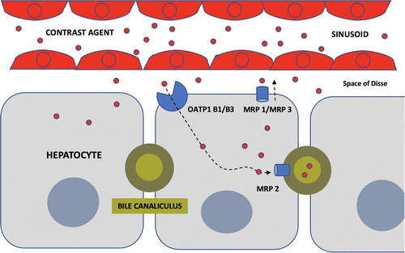
Gadoxetic acid DCE-MRI
MRI contrast agent
Liver-specific
Primovist/Eovist
DCE: Dynamic contrast enhanced

Slide 16
Gadoxetate DCE-MRI – diagnostic setting
Baseline phase
Arterial phase
Portal venous phase
Hepatocyte phase
CA injection
time
IMAGES REDACTED
Information on liver cell function
Difficulties in timing the phases
Breath-holds
Qualitative interpretation of liver function

Slide 17
Quantitative DCE-MRI
Pseudo-continuous 3D MRI acquisition
CA injection
time
Free breathing
Quantitative modelling of pharmacokinetics
IMAGES REDACTED

Slide 18
Quantitative DCE-MRI
Fidel’s PhD project
Pseudo-continuous 3D MRI acquisition
CA injection
time
radial acquisition technique with golden angle sampling and compressed sensing (GRASP)
pre-product sequence from NYU allows retrospective reconstruction from k-space
optimal temporal spacing
motion averaged
IMAGES REDACTED

Slide 19
Quantitative DCE-MRI
Fidel’s PhD project
Pseudo-continuous 3D MRI acquisition
CA injection
time
IMAGES REDACTED

Slide 20
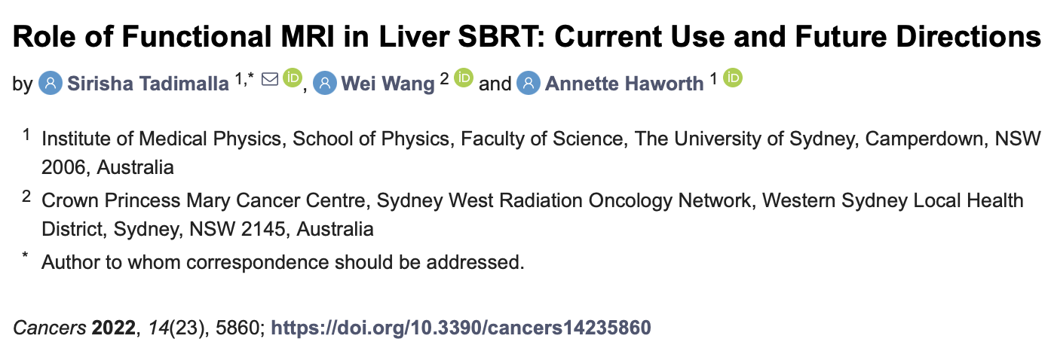
Why quantitative?
“there is no absolute threshold to separate parameter values indicating high and low liver function”

Slide 21
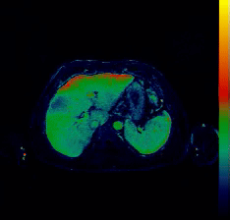
PRISM clinical trial
AIM: To determine the feasibility of personalized liver SBRT using MRI
30 patients with liver cancer (20 HCC, 10 Liver metastases)
CP A, CP B7/8
non-cirrhotic
Radiation treatment
3 months

Slide 22
PRISM clinical trial
Site: Westmead Hospital, PI: A/Prof. Tim Wang
Three stage design
n=5
pilot
n=10
Is there a dose-function relationship?
n=15
Compare PRISM plans (initial and mid-Tx) vs standard plans
lower toxicity?
higher dose to tumour?

Slide 23
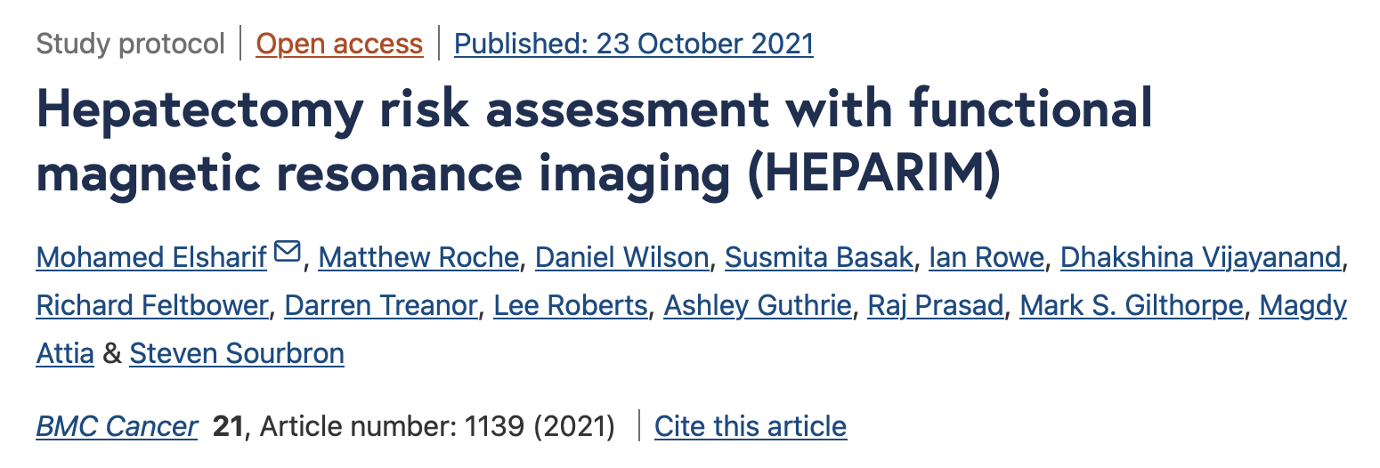
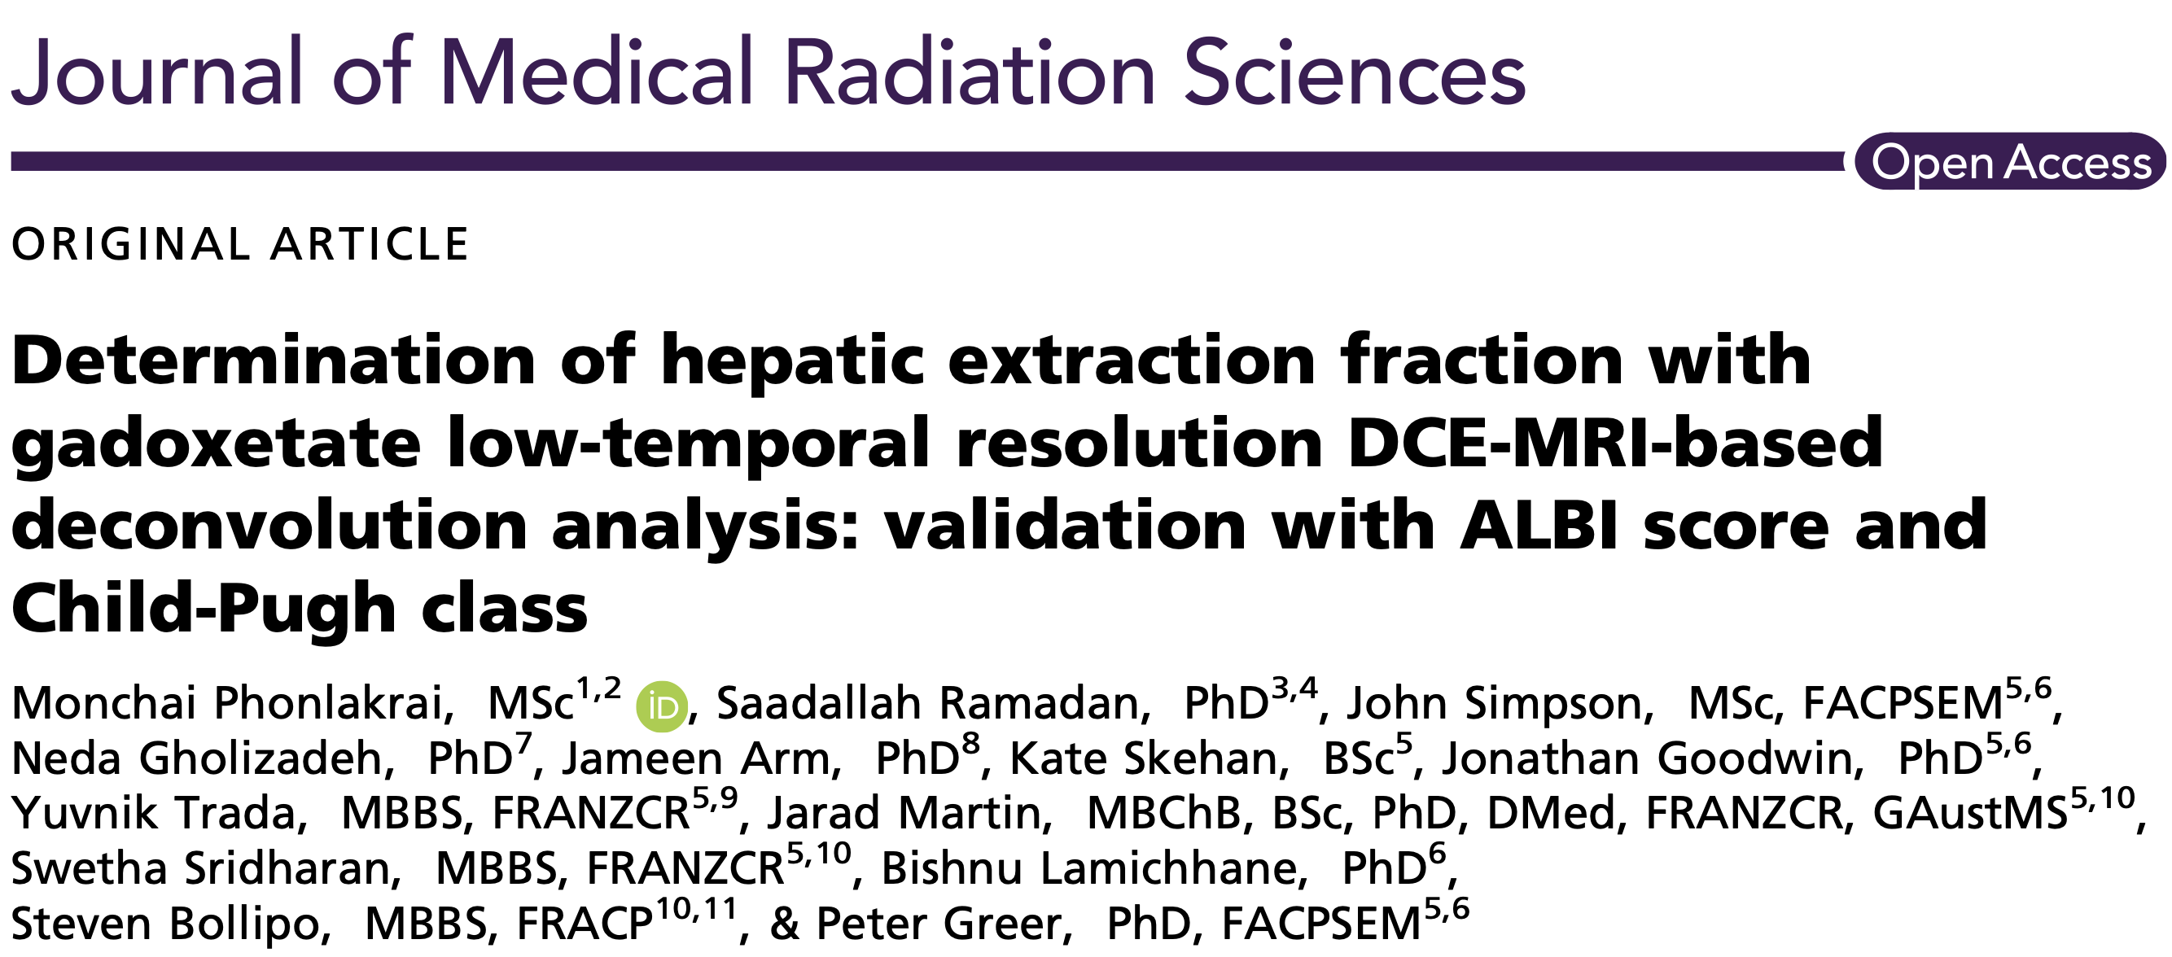
Validation & Future work
HEPARIM
Quantitative Gadoxetate DCE-MRI to predict liver function reserve after hepatectomy
cohort: liver metastases, ~150
secondary measure: ICG
PRISM
Other sites in Australia
Multi-center clinical trial

Slide 24
Acknowledgements
PRISM Trial Management Committee
Westmead Hospital
Sheryl Foster, Nick Sanaei, Anthea Min
David Farlow, Robbie Barnett, Andrew Chicco
Tracy Pearl-Larson, Zalak Patel
University of Sydney
BiRT team, Fidel Navarro, Erin Wang
Calvary Mater Newcastle
Jonathan Goodwin, Peter Greer, Kate Skehan
University of Sheffield, UK
Steven Sourbron

Slide 25
Questions?
sirisha.tadimalla@sydney.edu.au
Dr. Sirisha Tadimalla
Cancer Institute NSW Early Career Fellow
MRI Physicist
Institute of Medical Physics, Faculty of Science
The University of Sydney
https://birt.sydney.edu.au

