Slide 1
Putting the Blame on Planning: Housing Crisis and Reform in Ireland
Dr Declan Redmond Associate Professor of Housing and Planning
School of Architecture, Planning and Environmental Policy University College Dublin
May 18th, 2023, University of Sydney, Henry Halloran Trust

Slide 2

Housing the Political Issue in Ireland

Slide 3


Homelessness-
Sleeping in a Police Station

Slide 4
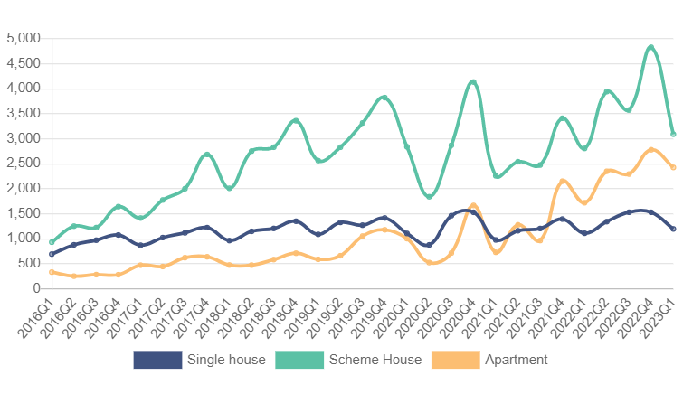
Dwelling Completions
Annual demand/need
35,000 to 60,000

Slide 5
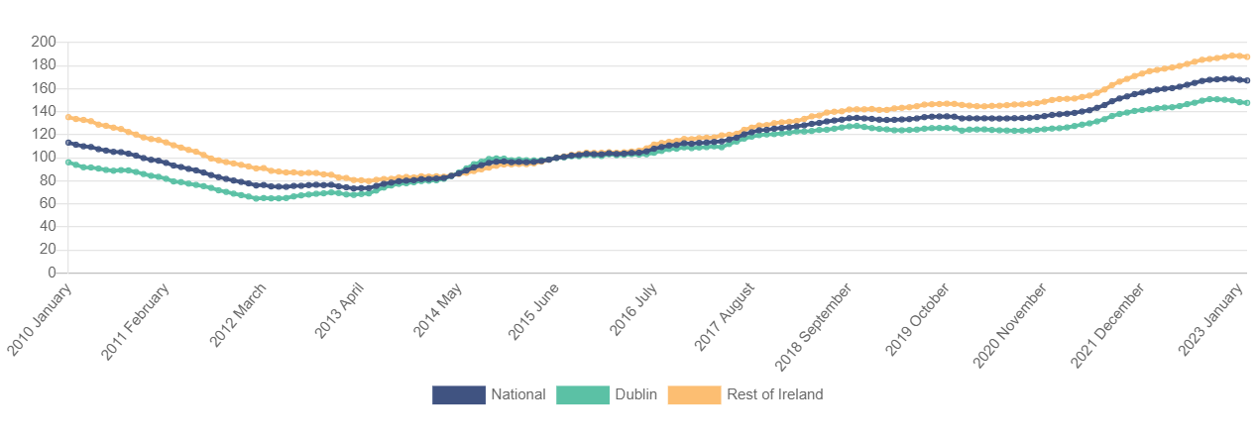
Property Price Index (surpassed Celtic Tiger)

Slide 6
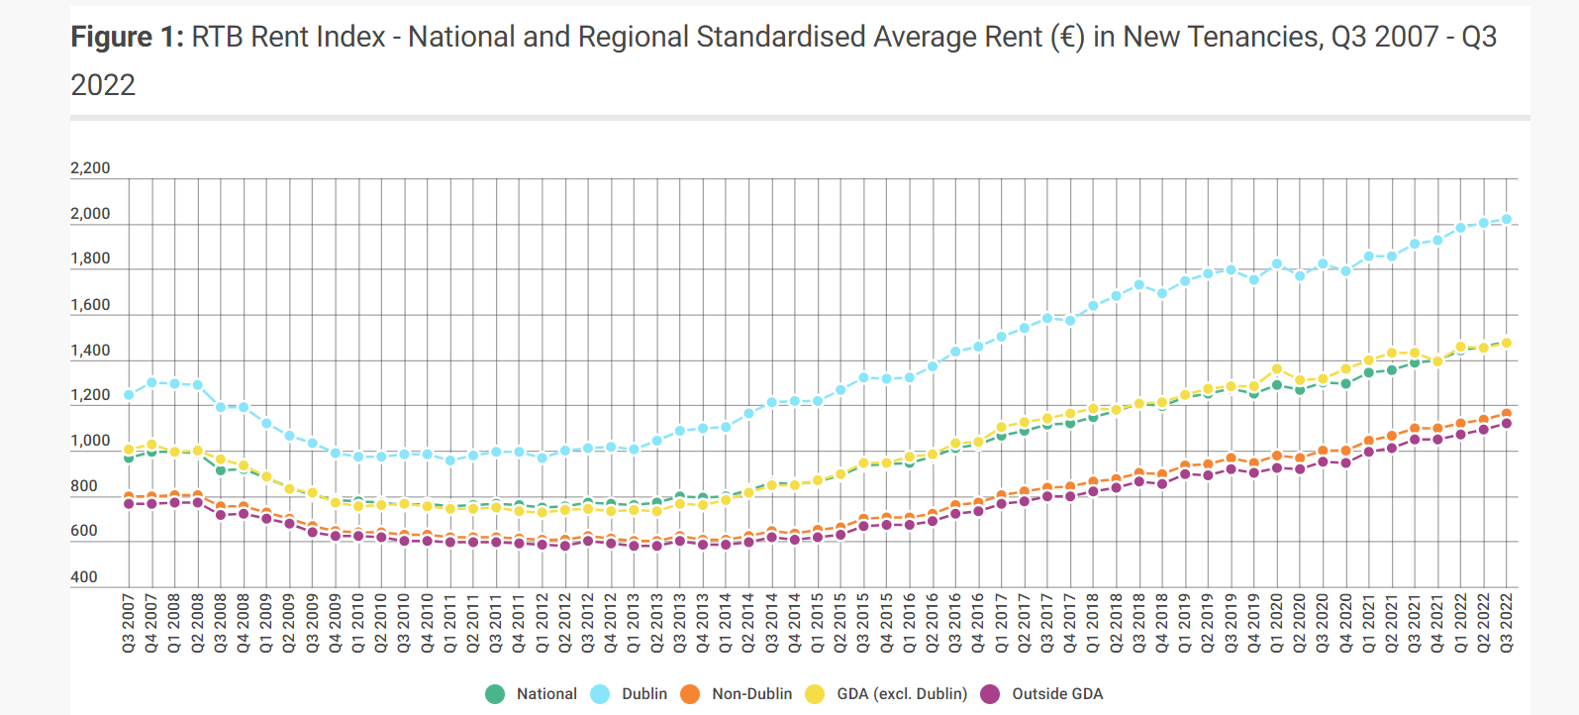
Rents [Rental Crisis]

Slide 7

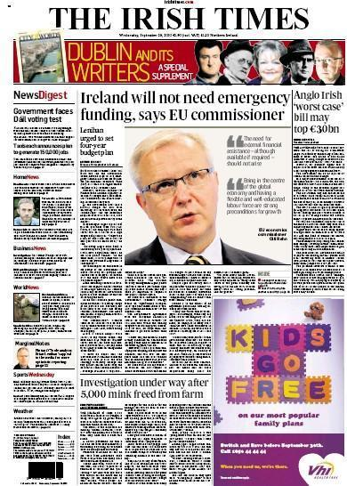
‘Celtic Tiger’
Troika and Bailout

Slide 8
After the Crash…still?: A dysfunctional system
Broken banks
Broken developers
State debt
Little social housebuilding
Little private housebuilding
Homelessness increased rapidly
Social housing waiting lists rocketied
High Mortgage arrears

Slide 9
Recalibrating Planning
The ‘Viability Gap’

Slide 10
Who and what is to blame? The Argument of the Property Lobby
Planning
Finance & Fiscal
Developers unable to access low-cost finance
Building Standards are Overly Generous
Planning System is Overly Democratic
Planners don’t understand financial implications of decisions
Switch from bank debt to equity-based model
New fiscal incentives & investment structures (REITs) needed
Planning making development ‘unviable’

Slide 11




Planning System Presented as Barrier
The planning system is not set up to facilitate development-it's set up to slow down development…there needs to be a shift in perspective and for the people processing applications to become more collaborative” (Brian Moran Chairman of Urban Land Institute Ireland, 2016)
‘provide thought leadership’
“We need an emergency planning framework for two years or three years so that you get through the [Planning Approval System] within two months ….We need to fast-track planning” (PII, 2016)

Slide 12
Lobbying and Evidence ???
Wish List

Slide 13
Reshaping planning policy- lobbying wins to date
Specific Planning Policy Requirements
Reduction in development levies
Reduction in planning gain commitments
New Apartment typologies- BTR and co-living
Reduction in minimum apartment sizes and mixes
Fast track planning
Major increase in densities and heights
Subsidising apartment development

Slide 14
Changing typologies and Standards

Slide 15
Changing Planning: ‘Guidelines’
National Planning Framework
Increase densities
Apartment Guidelines
Height Guidelines
Compact growth guidelines
‘Guidelines’ are often compulsory for municipalities

Slide 16
Rise of international investors who want to buy apartment schemes for rent
Development finance is scarce, so investors encouraged
REITS etc

Slide 17
Rise of Viability as a policy consideration
‘….. while appropriate standards of accommodation are set from a long-term planning and sustainable development perspective, it is important that such standards are compatible with economically viable housing supply

Slide 18

New apartment types [industry demand]
Co-Living
Build to Rent
‘community curator’
‘boutique living’
Must be rented for 15 years
Institutional Investors

Slide 19
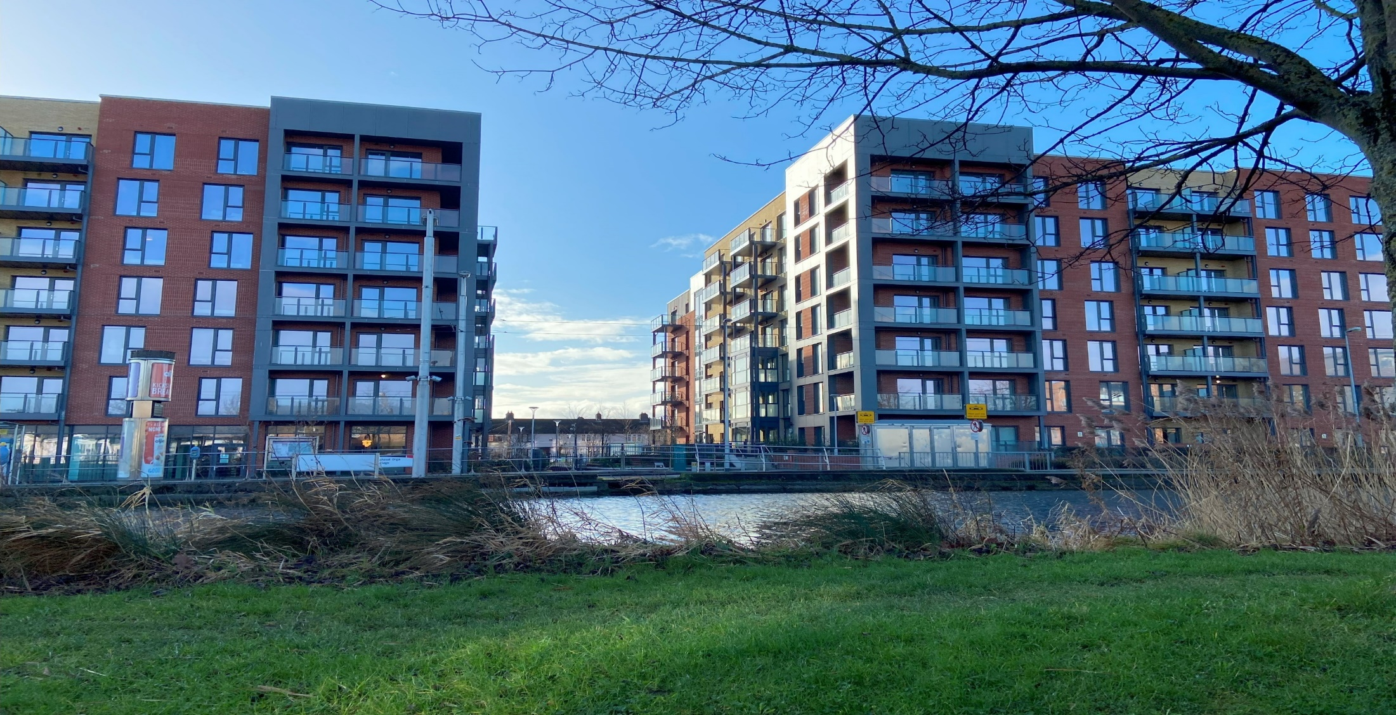
Apartment mix
BTR Developments may have 100% studio apartments
BTR
AUD 3200 per month for one bed

Slide 20
Density rules relaxed- compat growth
Centrally and/or accessible urban locations | No density limits
Intermediate urban locations | No density limits
Peripheral and/or less accessible urban locations | Minimum density of 45 per hectare
Notes:
locations for apartment development should be where public transportation, urban amenities is well organised and provided, or were close to employment locations.
This is the first time that the locations identified as suitable for apartment development were listed in Apartment Guidelines, and suggestions were provided for three types of location in cities and towns as shown in the table

Slide 21
Recent Incentives

Slide 22
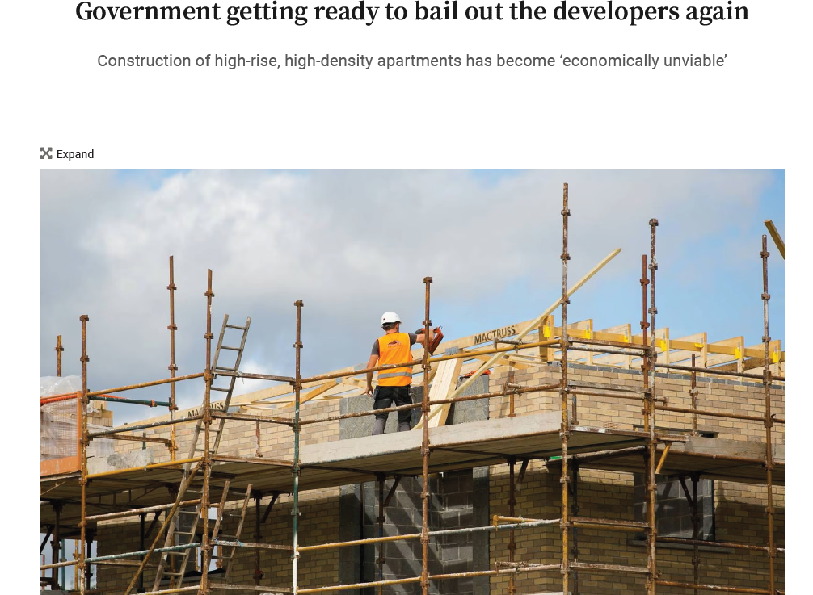
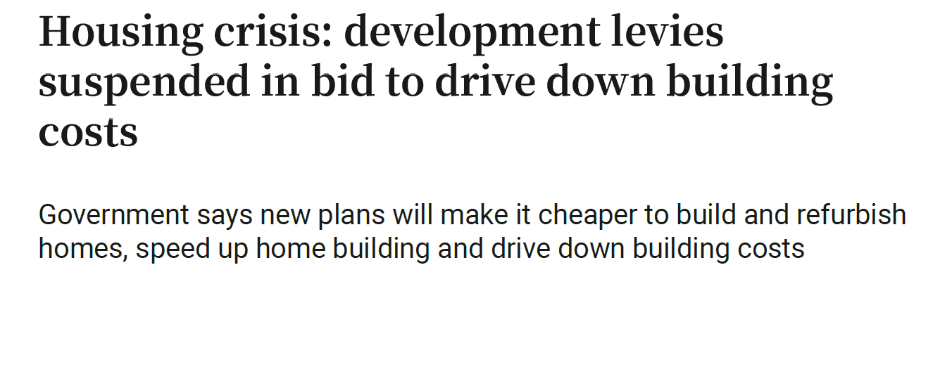
Recent Incentives: Subsidizing apartment development

Slide 23
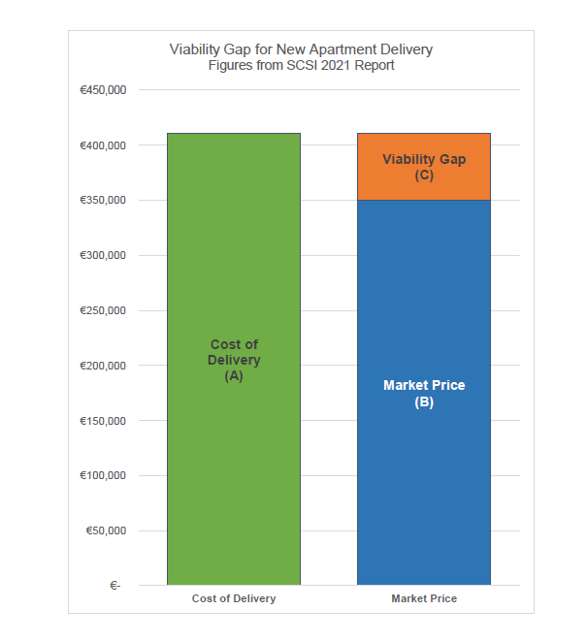
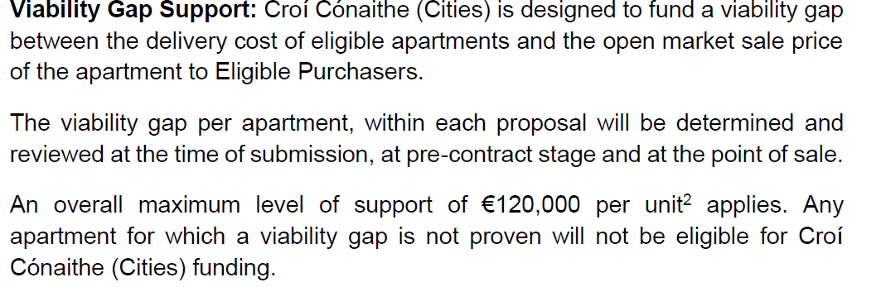
Viability Gap

Slide 24
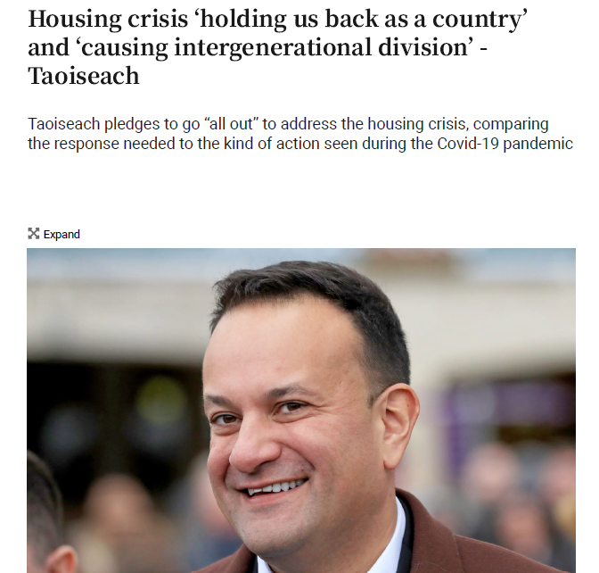
Next General Election

Slide 25
Finally
There is significant investment in social and affordable housing, but slow progress
Cost rental housing is being promoted
Land Development Agency may make a difference
Land Value Tax legislation is imminent

